Slide 1



Gandaki College of Engineering and Science
May, 2025
SMARTRESELL– A MARKETPLACE FOR SECOND-HAND MOBILE PHONES WITH AI-DRIVEN PRICE SUGGESTION
Presentation by
Bhawana KC
Kabita Adhikari
Prasamsha Tripathi

Slide 2
OVERVIEW
Introduction
Price Prediction Workflow
01
Required Tools
05
09
Problem Statement
Use Case Diagram
06
Excepted Outcomes
10
02
Objectives
03
ER Diagram
07
Work Plan and Timeline
11
Literature Review
04
System Methodology
08

Slide 3

INTRODUCTION
  A smart, AI-powered online marketplace for buying and selling second-hand mobile phones with accurate price suggestions.
  Why we need SmartResell?
    AI-driven price suggestions
    Trust badge system to increase credibility
    Admin verifies listings, manages users for quality assurance
    Sellers have guidance on market-based fair pricing
Page 1

Slide 4
PROBLEM STATEMENT
  Problems in Current Mobile Marketplaces:
    No smart tools for pricing
    Prices often too high or low
    Communication is slow and unclear
    Buyers and sellers lose trust
Page 2

Slide 5
OBJECTIVE
  Develop AI-powered price prediction system to guide sellers in setting fair prices for second-hand phones.
  Create a user-friendly web interface for listing and browsing phones.
  Provide smart suggestions to improve deal success rate
Page 3

Slide 6
LITERATURE REVIEW
  HamroBazar: Does not have smart pricing, even though it's popular and offers “Buy Now, Pay Later.”
  Swappa: Checks every product before selling, so buyers feel safe and trust the platform.
  Cashify: Helps people sell old devices quickly with instant payment and sells them again after fixing.
  OLX: Easy to use and free for everyone, but doesn’t check the quality of items.
  Back Market: Sells repaired devices with warranties, but it’s still hard for users to know if prices are fair.
Page 4

Slide 7
REQUIRED TOOLS
The following tools are used for development of this project:
  For frontend: HTML, CSS, JavaScript, Bootstrap
  For backend: Django
  Database: MySQL
  For UML diagrams and wireframes: Draw.io
  Machine Learning: Python(Scikit-learn)
  Web Scraping: BeautifulSoup
  For Gantt chart: MS-Excel
  For version control and collaboration: Git and GitHub
  For coding: Visual Studio Code
Page 5

Slide 8
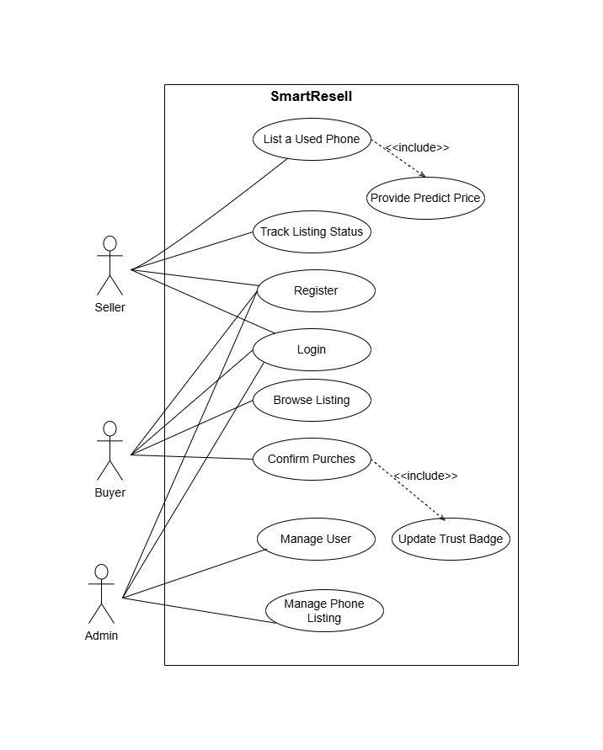
USE CASE DIAGRAM
Page 6

Slide 9
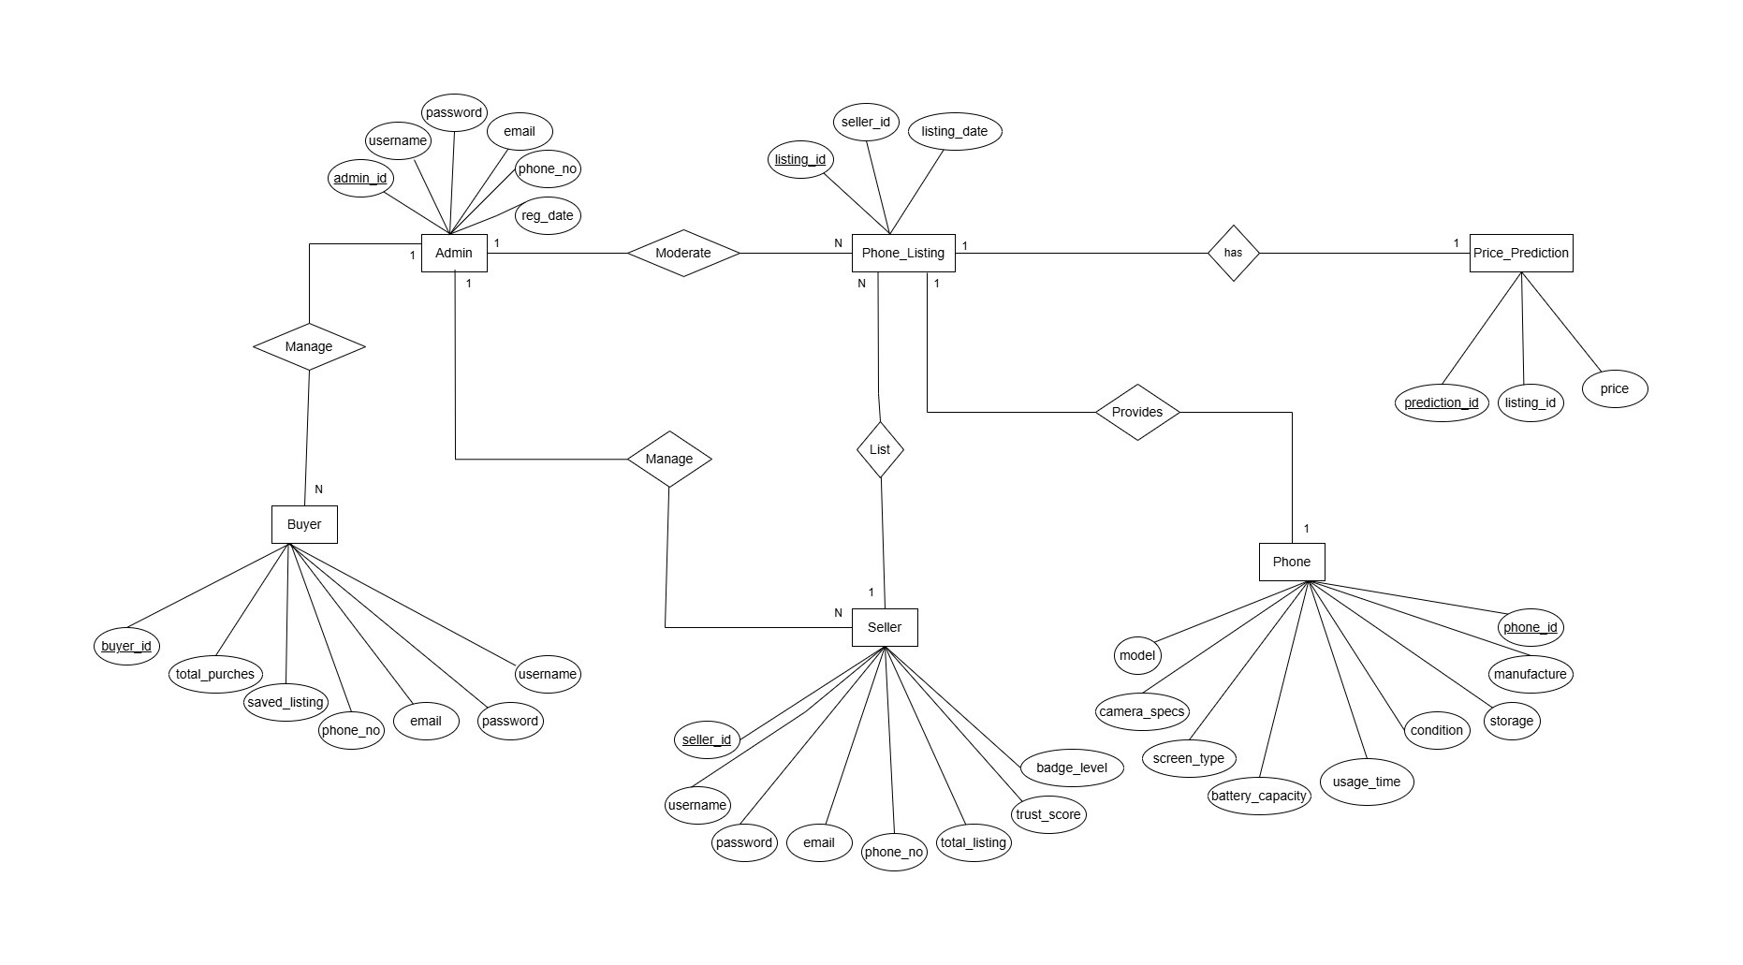
ER DIAGRAM
Page 7

Slide 10
SYSTEM METHODOLOGY
  Development Model: Waterfall
  Phases:
    Requirement Analysis
    System Design
    Coding
    Testing
    Deployment
    Maintenance
Page 8

Slide 11
PRICE PREDICTION WORKFLOW
  Data Collection: Scrape market data (e.g., HamroBazar).
  Preprocessing: Clean data, handle missing values.
  Feature Engineering – Create predictive attributes
  Model Training: Linear Regression
  Evaluation – Accuracy, F1, MAE, RMSE
  Deployment: API integration for real-time predictions.
Page 9

Slide 12
EXCEPTED OUTCOMES
  User-friendly interface for easy buying & selling.
  Analyzes real market data to suggest fair prices.
  Helps sellers avoid overpricing/underpricing.
  Trust badges awarded to reliable sellers.
  Admin monitors user activity, sales, and market trends.
Page 10

Slide 13
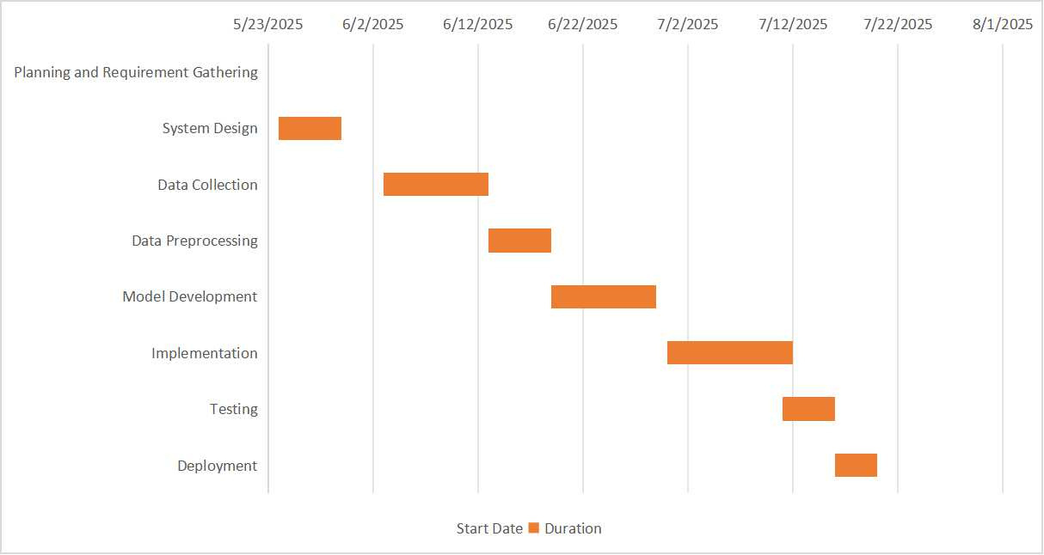
WORK PLAN AND TIMELINE
Page 11

Slide 14
THANK YOU

